Slide 1
Linear Algebra
Lecture 19

Slide 2
Determinants

Slide 3
Cramer's Rule,
Volume and Linear
Transformations

Slide 4
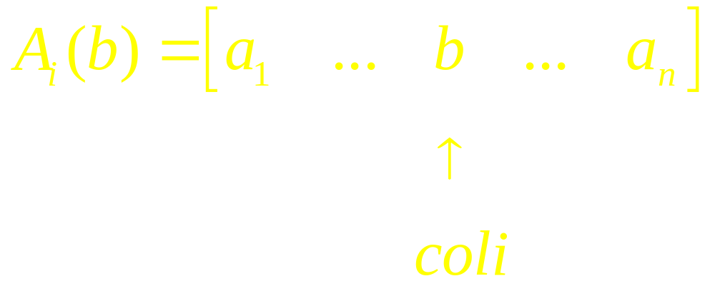
Observe
For any n x n matrix A and any b in R^{n}, let A_{i}(b) be the matrix obtained from A by replacing column i by the vector b.

Slide 5
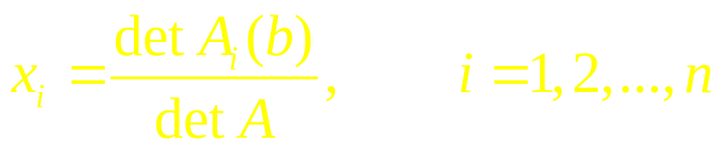
Theorem (Cramer's Rule)
Let A be an invertible n x n matrix. For any b in R^{n}, the unique solution x of Ax = b has entries given by

Slide 6
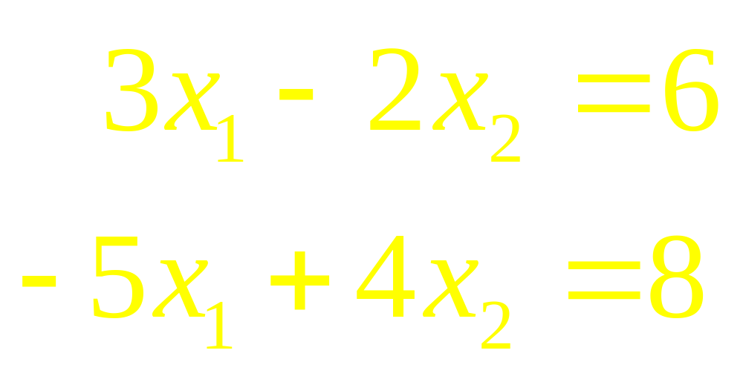
Example 1
Use Cramer’s rule to solve the system

Slide 7
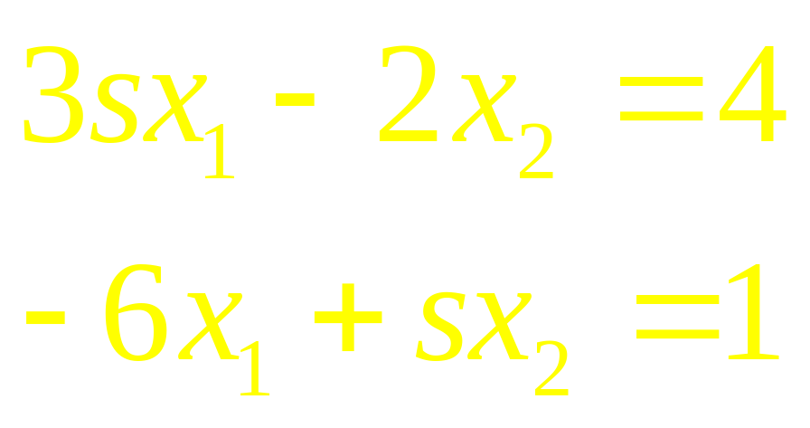
Example 2
Determine the values of s for which the system has a unique solution and use Cramer’s rule to describe the solution.

Slide 8
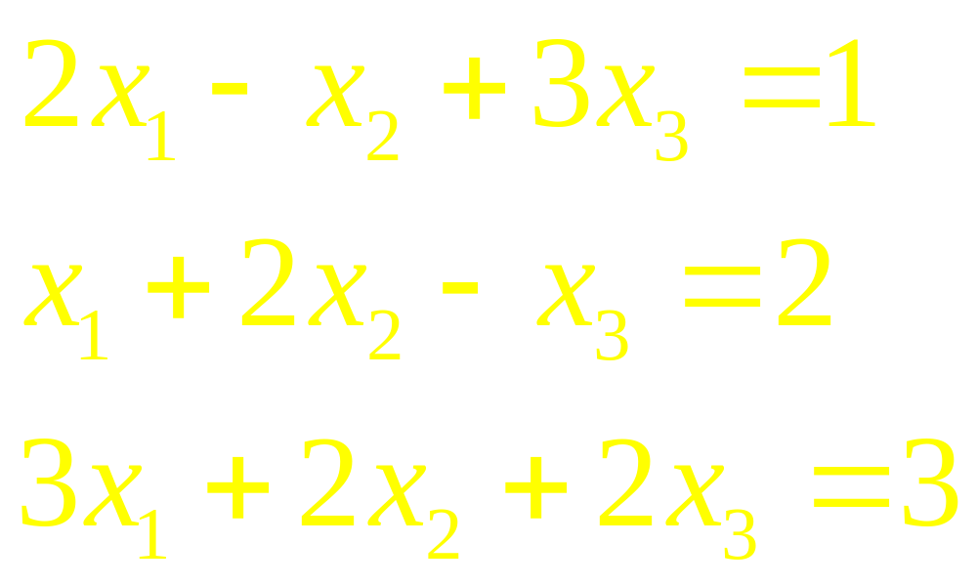
Example 3
Solve the system of equations:

Slide 9
Example 4
Use Cramer’s Rule to solve

Slide 10
A Formula for A ^{–1}
Cramer’s rule leads easily to a general formula for the inverse of an n x n matrix A. The jth column of A⁻¹ is a vector x that satisfies Ax = e_{j}, where e_{j} is the jth column of the identity matrix, and the ith entry of x is the

Slide 11
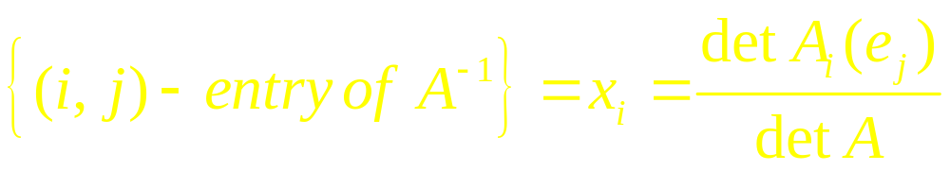
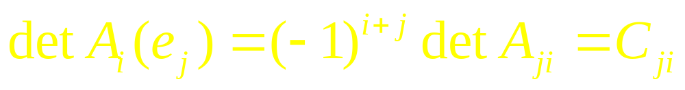
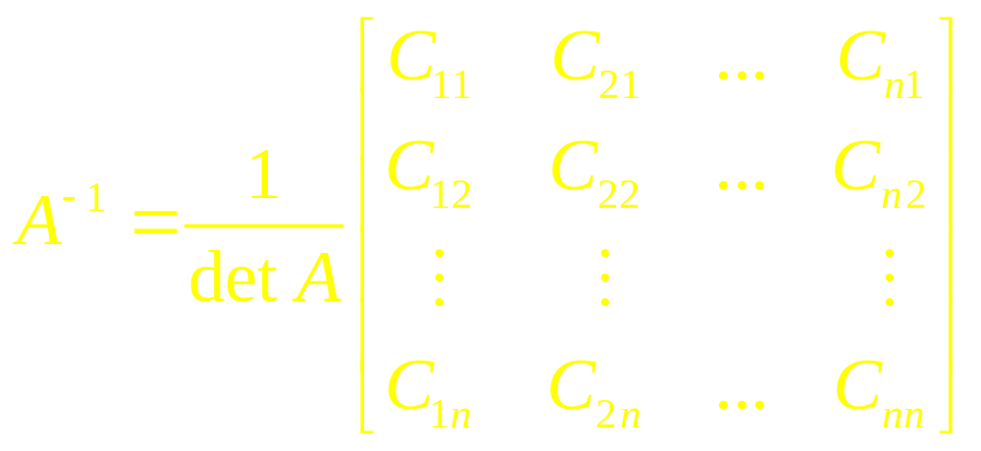
Continued
(i, j)-entry of A⁻¹ by Cramer’s rule,

Slide 12
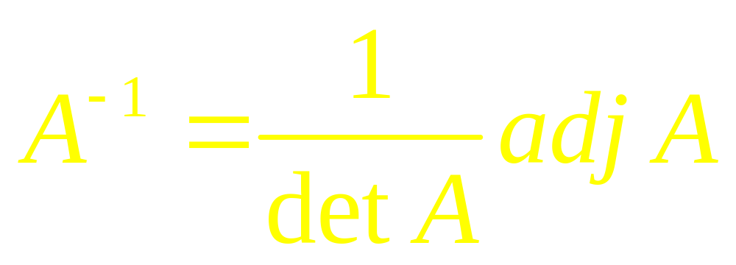
Theorem
Let A be an invertible matrix, then

Slide 13
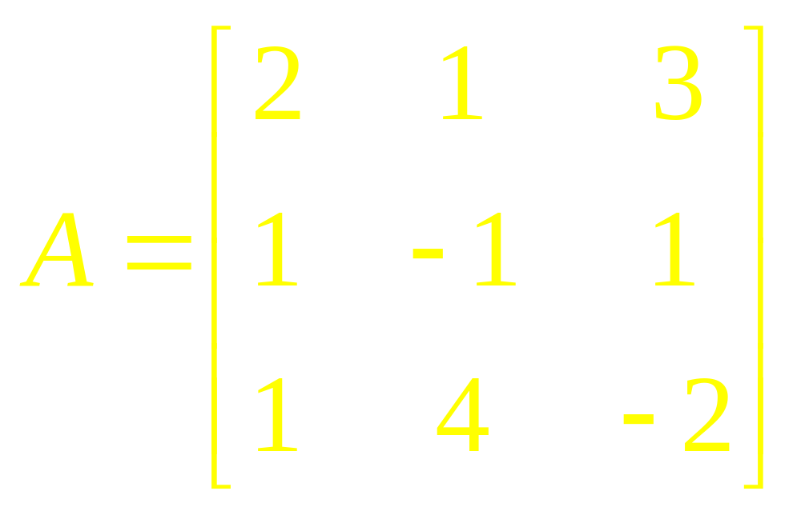
Example 5
Find the inverse of the matrix

Slide 14
Theorem
If A is a 2 x 2 matrix, the area of the parallelogram determined by the columns of A is |det A|. If A is a 3 x 3 matrix, the volume of the parallelepiped determined by the columns of A is |det A|.

Slide 15
Example 6
Calculate the area of the parallelogram determined by the points (-2, -2), (0, 3), (4, -1) and (6, 4).

Slide 16
Theorem
Let T: R² R² be the linear transformation determined by a 2 x 2 matrix A. If S is a parallelogram in R², then
{area of T (S)} = |detA|. {area of S}

Slide 17
Continued
If T is determined by a 3 x 3 matrix A, and if S is a parallelepiped in R³, then
{volume of T (S)} = |detA|. {volume of S}

Slide 18
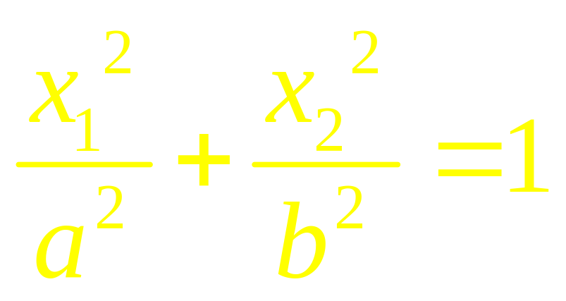
Example 7
Let a and b be positive numbers. Find the area of the region E bounded by the ellipse whose equation is

Slide 19
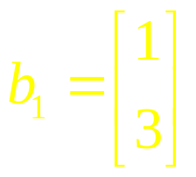
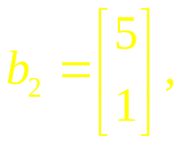
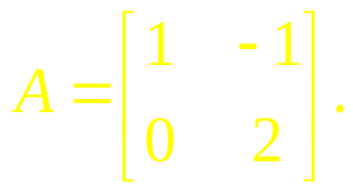
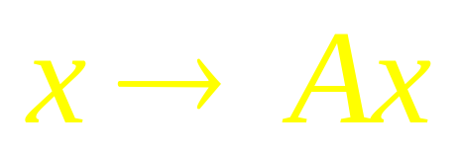
Example 8
Let S be the parallelogram determined by the vectors
and
and let
Compute the area of image of S under the mapping

Slide 20
Linear Algebra
Lecture 19

